Slide 1
Pronoun Study
Sipei Chen
Kearsten Collins
Jesse Hankins
Vincent Kovich
Britani Prescott
Jesse Raines
Liu Yu

Slide 2
Study Prompt
The study was meant to recognize and calculate the ratio of male to female pronouns in a text
Necessary to use texts in the public domain
Texts’ character set encodings: UTF-8

Slide 3
Background

Slide 4

Texts Analyzed
Jane Austen
Assumption: primarily female pronouns
122,189 words
Georgian England
Story of the lives of the five Bennet sisters when some members of the wealthy gentry move in to their neighborhood.

Slide 5
Texts Analyzed
Female Characters (11) | Male Characters (6)
Jane Bennet Elizabeth Bennet Mary Bennet Catherine Bennet Lydia Bennet Georgiana Darcy Lady Catherine De Bourgh Charlotte Lucas Miss Bingley Mrs. Bennet Mrs. Gardiner | Fitzwilliam Darcy Charles Bingley George Wickham Mr. Collins Mr. Bennet Mr. Gardiner

Slide 6

Texts Analyzed
Jules Verne
Assumption: primarily male pronouns
99,035 words
The adventure of three visitors who accidentally find themselves aboard the Nautilus, a mysterious submarine. They spend the rest of the time hunting underwater, fighting sharks, finding Atlantis, fighting a giant squid, and attempting to escape.

Slide 7
Texts Analyzed
Female Characters (~0) | Male Characters (7)
The Nautilus (This is the submarine, but it is referred to with female pronouns.) And others | Professor Pierre Aronnax Captain Nemo Ned Land Conseil Commander Farragut Captain Anderson Sir Samuel Cunard

Slide 8
Algorithm

Slide 9
Algorithm
Sort text into: pronouns and non-pronouns
Classify the pronouns as masculine, feminine, or neither
Keep individual counts of pronouns:
Masculine
Feminine
Neither
Total
Repeated for each text
Data can be combined to compare both texts
Sort text into: pronouns and non-pronouns
Classify the pronouns as masculine, feminine, or neither
Keep individual counts of pronouns:
Masculine
Feminine
Neither
Total
Calculate probability as specified pronouns divided by total pronouns
For each category of pronouns:
we multiply the number of pronouns in the selected category and multiply this by log base 10 of our calculated probability for the category
Sum the values for all three categories
To calculate logloss, multiply the previous value by 1 over the total number of pronouns overall

Slide 10
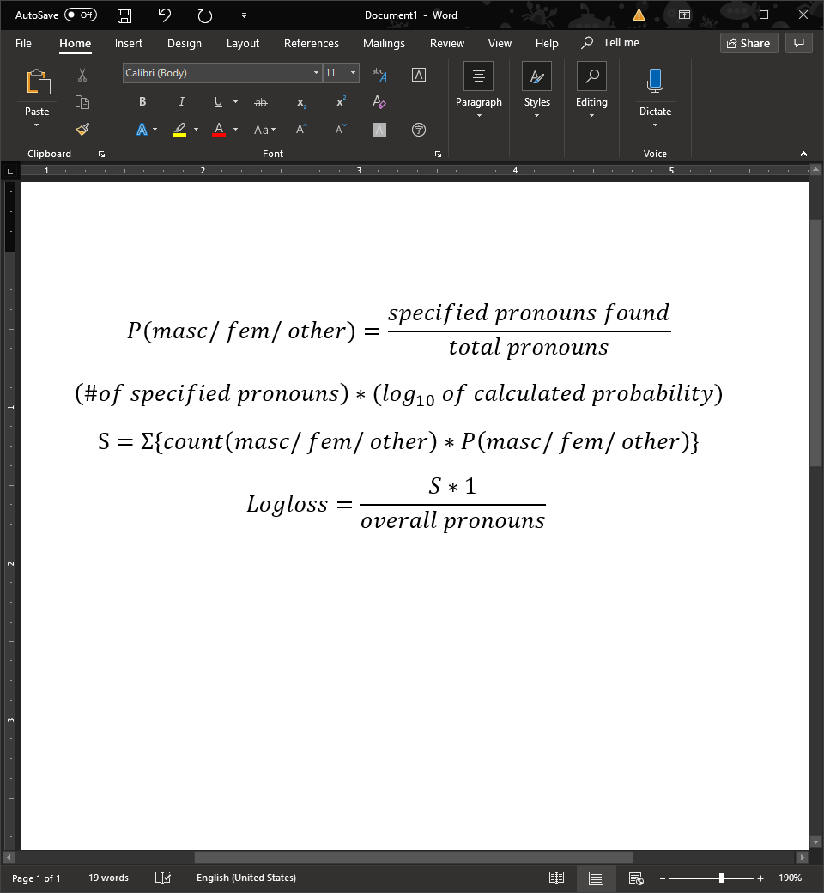
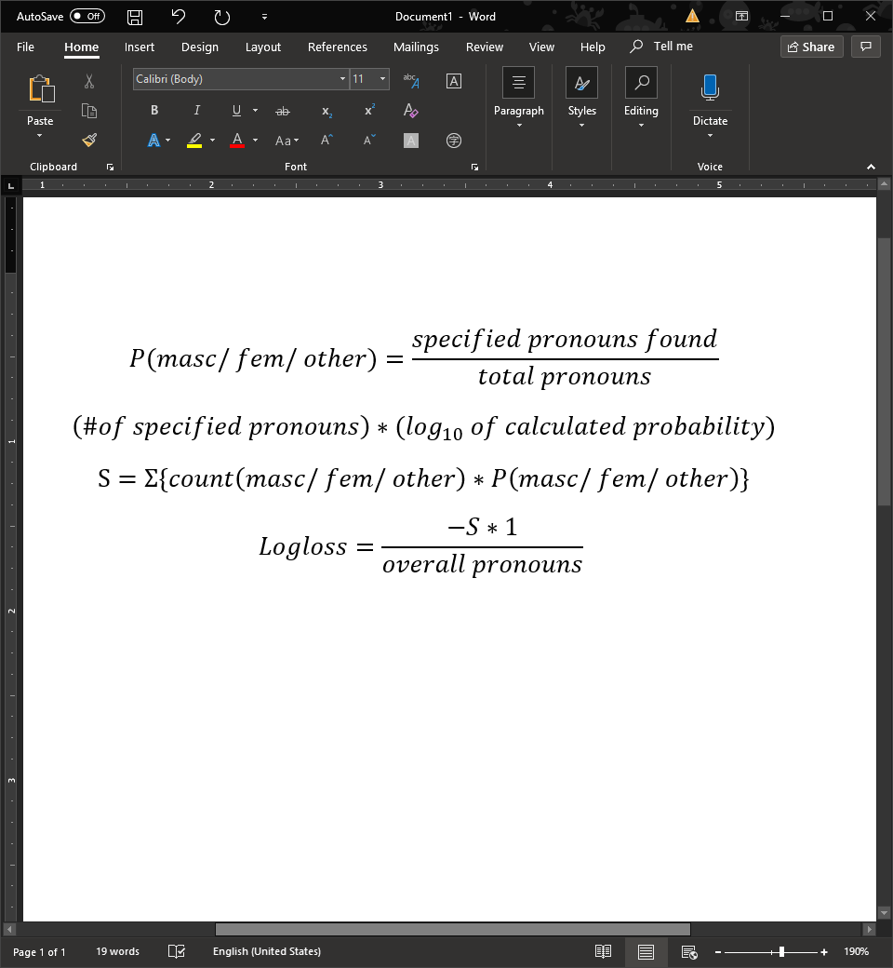
Algorithm
Calculate probability:
For each category of pronouns:
Sum the values each of the three categories:
Calculate log loss:

Slide 11
Results

Slide 12
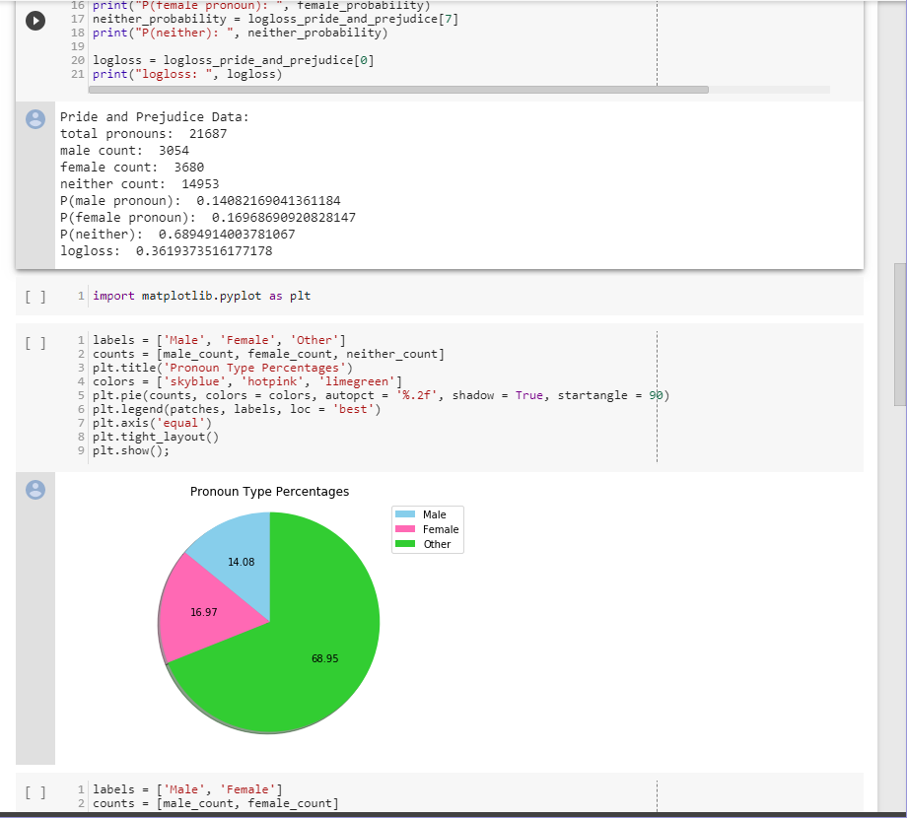
Data Example

Slide 13
Pride and Prejudice
Feminine Pronouns | 3,680
Masculine Pronouns | 3,054
Other Pronouns | 14,953
Total Pronouns | 21,687

Slide 14
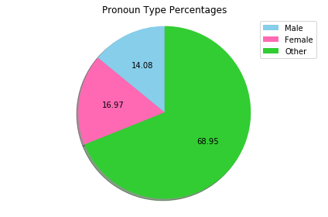
Overall Pride and Prejudice Comparison
Masculine Pronoun Probability | 0.1408
Feminine Pronoun Probability | 0.1696
Other Pronoun Probability | 0.6894

Slide 15
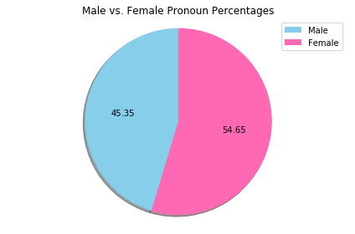
Direct Masc/Fem Comparison
Feminine Pronoun Probability | 0.5465
Masculine Pronoun Probability | 0.4535

Slide 16
20,000 Leagues Under the Sea
Feminine Pronouns | 117
Masculine Pronouns | 1,176
Other Pronouns | 12,278
Total Pronouns | 13,571

Slide 17
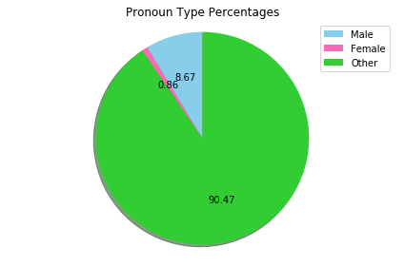
Overall 20,000 Leagues Under the Sea Comparison
Masculine Pronoun Probability | 0.0866
Feminine Pronoun Probability | 0.0086
Other Pronoun Probability | 0.9047

Slide 18
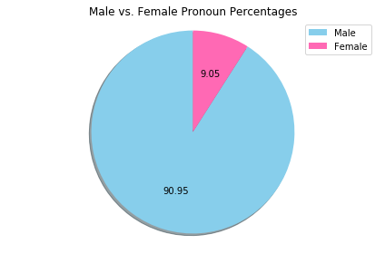
Direct Masc/Fem Comparison
Feminine Pronoun Probability | 0.0905
Masculine Pronoun Probability | 0.9095

Slide 19
Comparing Both Books
Pride and Prejudice Log loss: 0.3619
20,000 Leagues Under the Sea Log Loss:
0.1491
The closer to zero, the better the score
Better chance at predicting the pronoun in the second book

Slide 20
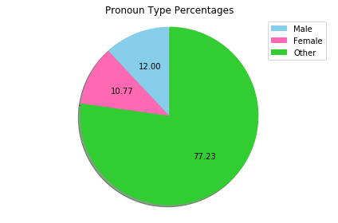
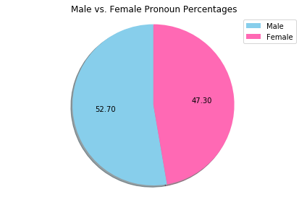
Comparing Both Books
Masculine Pronoun Probability | 0.1200
Feminine Pronoun Probability | 0.1077
Other Pronoun Probability | 0.7723
Feminine Pronoun Probability | 0.4730
Masculine Pronoun Probability | 0.5270

